Slide 1
안드로이드 실무 2주차 과제
1901055 정시철

Slide 2
Report 1
A TextView J RadioGroup S Chronometer
B EditText K CheckBox P TextClock
C Button L Switch U CalendarView
D CheckedTextView M ToggleButton V SearchView
E AutoCompleteTextview N DatePicker
F MultiAutoCompleteTextview O TimePicker
G ImageButton P ProgressBar
H ImageView Q SeekBar
I RadioButton R RatingBar

Slide 3
Report 2
방법 1
방법 2
방법 3
방법 4
방법 5

Slide 4
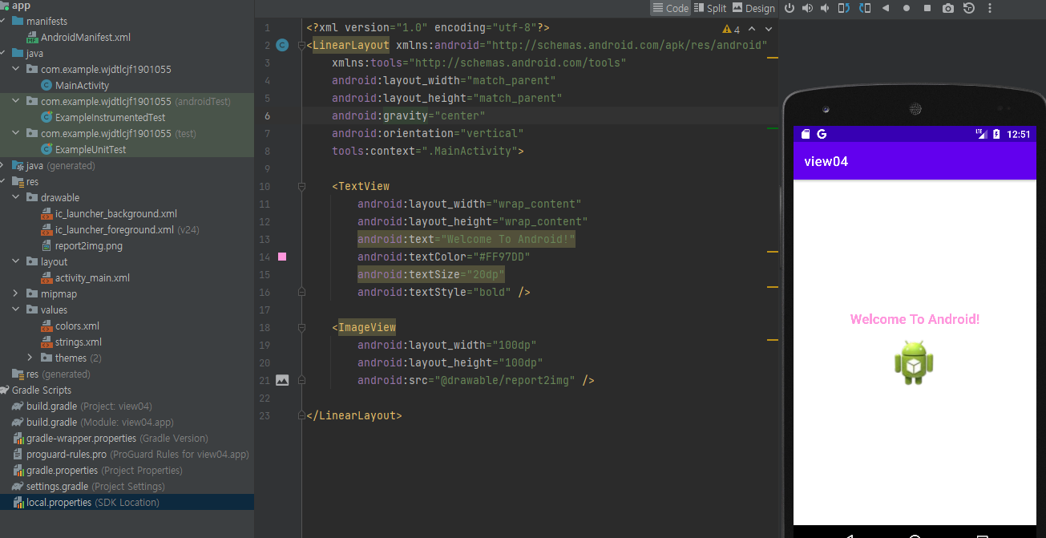
Report 3
gravity를 이용해서 이미지를 정렬
세로로 정렬하기 위해 orientation을 vertical으로 설정한다.
<?xml version="1.0" encoding="utf-8"?> <LinearLayout xmlns:android="http://schemas.android.com/apk/res/android" xmlns:tools="http://schemas.android.com/tools" android:layout_width="match_parent" android:layout_height="match_parent" android:gravity="center" android:orientation="vertical" tools:context=".MainActivity"> <TextView android:layout_width="wrap_content" android:layout_height="wrap_content" android:text="Welcome To Android!" android:textColor="#FF97DD" android:textSize="20dp" android:textStyle="bold" /> <ImageView android:layout_width="100dp" android:layout_height="100dp" android:src="@drawable/report2img" /> </LinearLayout>

Slide 5
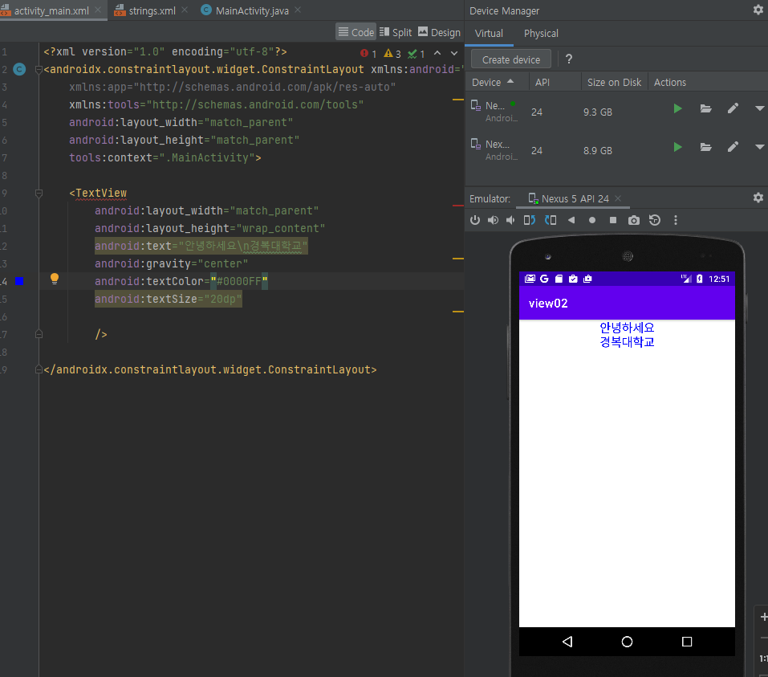
Report 2 방법 1
기본적으로 activity_main만 건들여서 작업할 때
<?xml version="1.0" encoding="utf-8"?> <androidx.constraintlayout.widget.ConstraintLayout xmlns:android="http://schemas.android.com/apk/res/android" xmlns:app="http://schemas.android.com/apk/res-auto" xmlns:tools="http://schemas.android.com/tools" android:layout_width="match_parent" android:layout_height="match_parent" tools:context=".MainActivity"> <TextView android:layout_width="match_parent" android:layout_height="wrap_content" android:text="안녕하세요\n경복대학교" android:gravity="center" android:textColor="#0000FF" android:textSize="20dp" /> </androidx.constraintlayout.widget.ConstraintLayout>

Slide 6
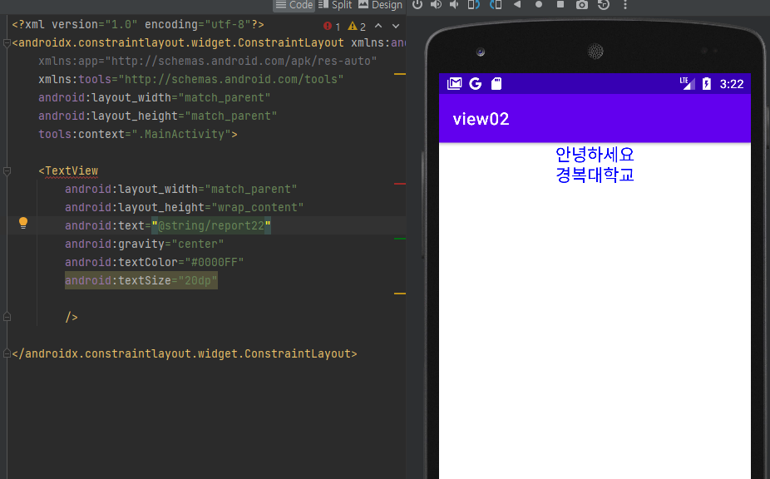
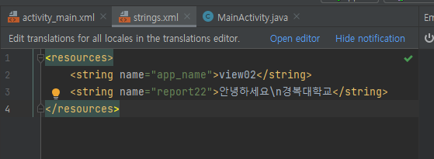
Report 2 방법 2
string.xml에서 문자열을 불러와서 작업할 때
<?xml version="1.0" encoding="utf-8"?> <androidx.constraintlayout.widget.ConstraintLayout xmlns:android="http://schemas.android.com/apk/res/android" xmlns:app="http://schemas.android.com/apk/res-auto" xmlns:tools="http://schemas.android.com/tools" android:layout_width="match_parent" android:layout_height="match_parent" tools:context=".MainActivity"> <TextView android:layout_width="match_parent" android:layout_height="wrap_content" android:text="@string/report22" android:gravity="center" android:textColor="#0000FF" android:textSize="20dp" /> </androidx.constraintlayout.widget.ConstraintLayout>
<resources> <string name="app_name">view02</string> <string name="report22">안녕하세요\n경복대학교</string> </resources>

Slide 7
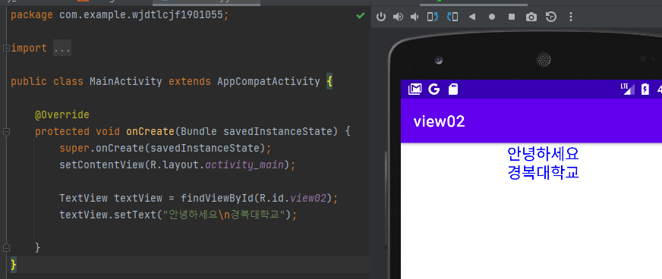
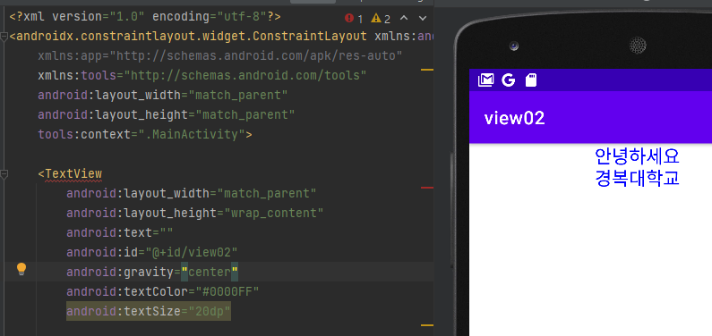
Report 2 방법 3
xml의 TextView의 id값을 이용해서 java에서 직접 입력하는법
package com.example.wjdtlcjf1901055; import androidx.appcompat.app.AppCompatActivity; import android.graphics.Color; import android.os.Bundle; import android.widget.LinearLayout; import android.widget.TextView; public class MainActivity extends AppCompatActivity { @Override protected void onCreate(Bundle savedInstanceState) { super.onCreate(savedInstanceState); setContentView(R.layout.activity_main); TextView textView = findViewById(R.id.view02); textView.setText("안녕하세요\n경복대학교"); } }
<?xml version="1.0" encoding="utf-8"?> <androidx.constraintlayout.widget.ConstraintLayout xmlns:android="http://schemas.android.com/apk/res/android" xmlns:app="http://schemas.android.com/apk/res-auto" xmlns:tools="http://schemas.android.com/tools" android:layout_width="match_parent" android:layout_height="match_parent" tools:context=".MainActivity"> <TextView android:layout_width="match_parent" android:layout_height="wrap_content" android:text="" android:id="@+id/view02" android:gravity="center" android:textColor="#0000FF" android:textSize="20dp" /> </androidx.constraintlayout.widget.ConstraintLayout>

Slide 8
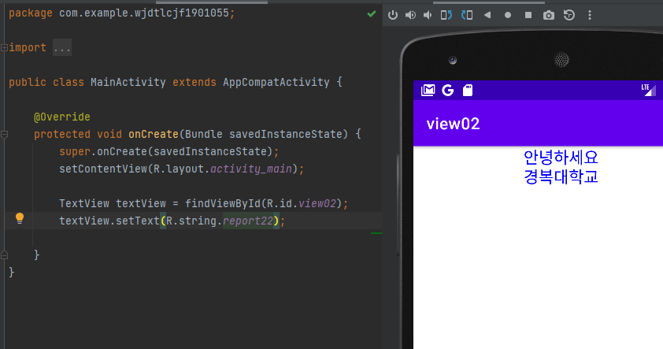
Report 2 방법 4
res/values/strings.xml에 문자열을 입력하고, TextView의 ID값을 이용해서 JAVA 코드에서 연결하는 방법
3의 방식에서 setText에 string을 연결한다.
package com.example.wjdtlcjf1901055; import androidx.appcompat.app.AppCompatActivity; import android.graphics.Color; import android.os.Bundle; import android.widget.LinearLayout; import android.widget.TextView; public class MainActivity extends AppCompatActivity { @Override protected void onCreate(Bundle savedInstanceState) { super.onCreate(savedInstanceState); setContentView(R.layout.activity_main); TextView textView = findViewById(R.id.view02); textView.setText(R.string.report22); } }

Slide 9
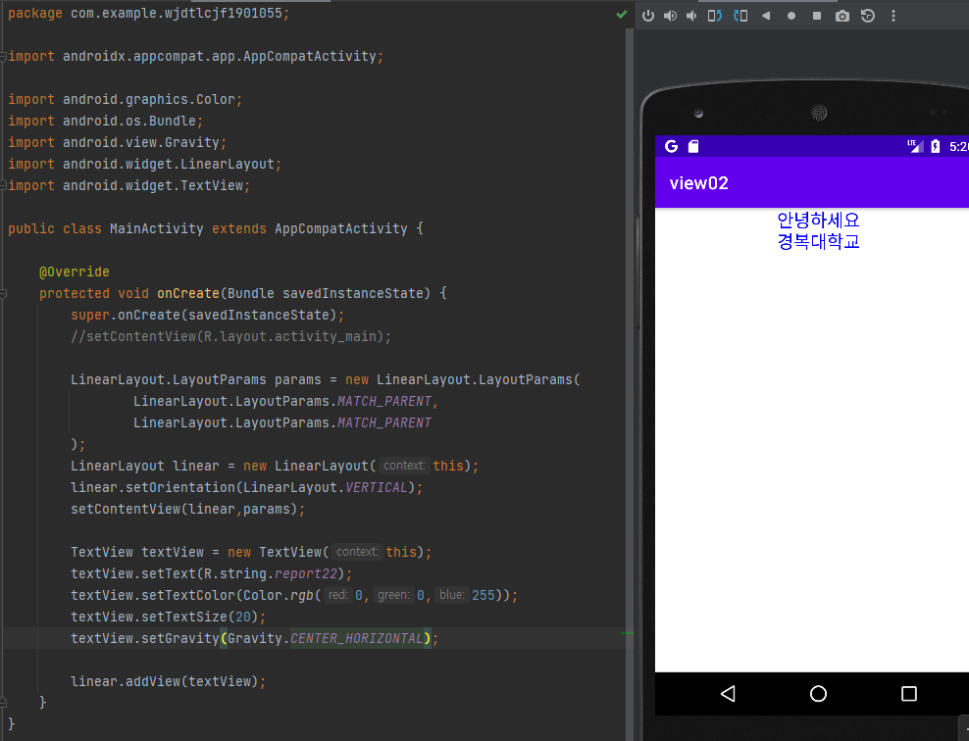
Report 2 방법 5
Java 코드로만 작성하는 방법
package com.example.wjdtlcjf1901055; import androidx.appcompat.app.AppCompatActivity; import android.graphics.Color; import android.os.Bundle; import android.view.Gravity; import android.widget.LinearLayout; import android.widget.TextView; public class MainActivity extends AppCompatActivity { @Override protected void onCreate(Bundle savedInstanceState) { super.onCreate(savedInstanceState); //setContentView(R.layout.activity_main); LinearLayout.LayoutParams params = new LinearLayout.LayoutParams( LinearLayout.LayoutParams.MATCH_PARENT, LinearLayout.LayoutParams.MATCH_PARENT ); LinearLayout linear = new LinearLayout(this); linear.setOrientation(LinearLayout.VERTICAL); setContentView(linear,params); TextView textView = new TextView(this); textView.setText(R.string.report22); textView.setTextColor(Color.rgb(0,0,255)); textView.setTextSize(20); textView.setGravity(Gravity.CENTER_HORIZONTAL); linear.addView(textView); } }

